Slide 1
A negative category based approach for Wikipedia document classification International Journal of Knowledge Engineering and Data Mining Meenakshi Sundaram Murugeshan , K. Lakshmi , Saswati Mukherjee
報告者：610721204 陳克威
日 期：2019/12/25 (Xmas)

Slide 2
Outline
Introduction
Related Work
Classification of Wikipedia documents
Experimental results and evaluation
Conclusions

Slide 3
Introduction

Slide 4
Introduction
The task in classification is to classify the documents into predefined categories.
INEX, which is a forerunner in the field of exploiting semi-structured data, promotes the research on XML documents using the Wikipedia corpus.

Slide 5
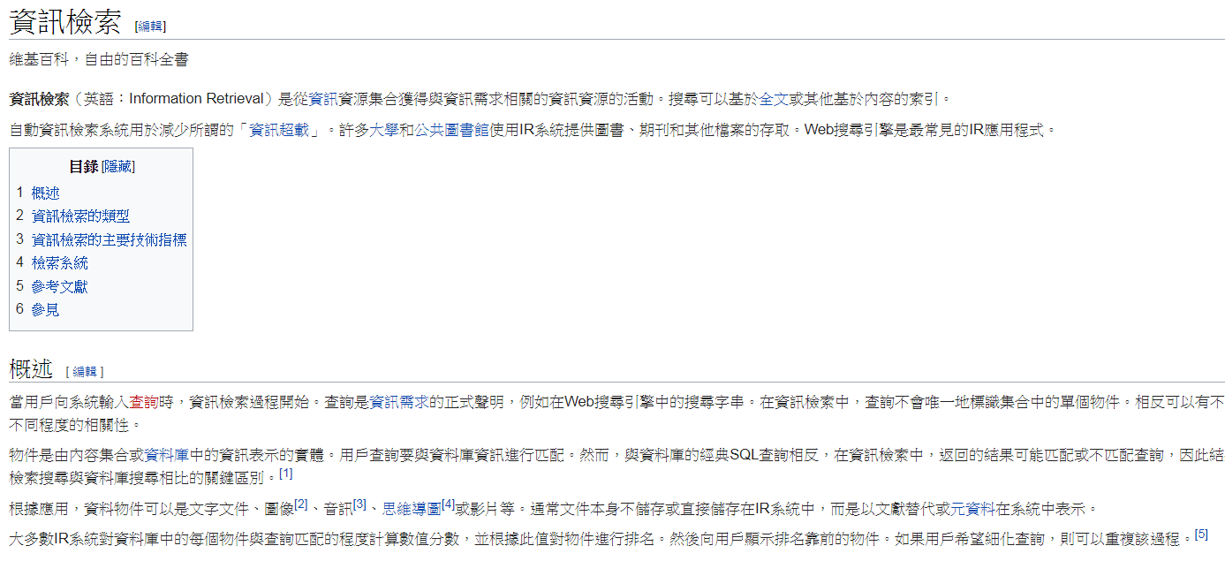
Introduction
Title of sections
IDES
Notes:
不同的section可能有不同的重要性

Slide 6
Introduction
The challenge in any Wikipedia document related research is to maximise the utilisation of the structural information available in such documents.
This research uses a combination of the IDES of the Wikipedia document along with the titles of the sections and subsections for classification of these documents.

Slide 7
Profile-based classification
The method that we have adopted for the XML classification in this research is profile-based classification.
Profiles are vectors, containing features and their weights, which are used as representation of documents in a category.
In profile-based method, the profiles of the documents in training set are used to form profiles for each category.
Since the total number of terms collected from the training set per category is large, dimensionality reduction is a necessary requirement.
Notes:
(3)畫圖

Slide 8
TF-IDF & RF for weighting
The most popular feature weighting schemes are the term frequency (TF) and average TF*IDF feature selection methods.
Terms are given weights based on their presence in positive and negative categories in the relevance frequency (RF) method (Yang et al., 2002).

Slide 9
NCD for weighting
When such negative documents are clustered in lesser number of negative categories, the power of contribution of the term to the positive category reduces considerably.
This factor has been taken care of in the method of negative category document frequency (NCD).

Slide 10
Similarity
Since fractional similarity measure (Lakshmi and Mukherjee, 2006) has shown better performance in text classification on various datasets, we chose to use fractional similarity measure.
The most widely used similarity measure is cosine similarity which is used as a benchmark for comparing our similarity measure score in this paper.

Slide 11
Related Work

Slide 12
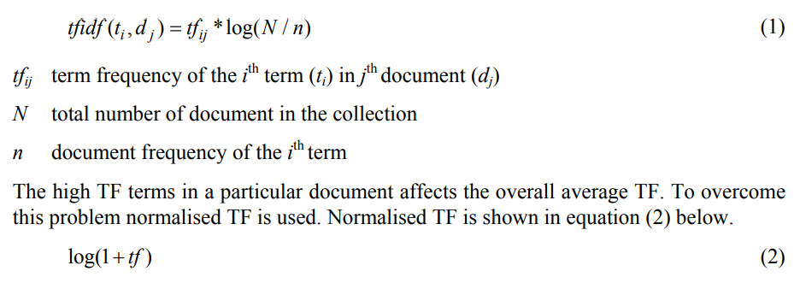
TF-IDF

Slide 13
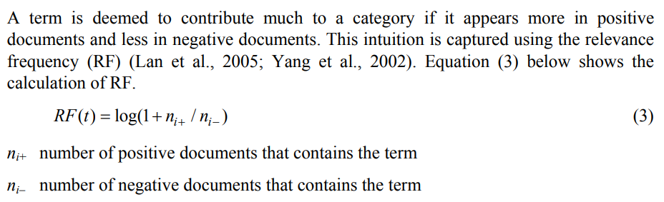
RF - Relevance Frequency

Slide 14
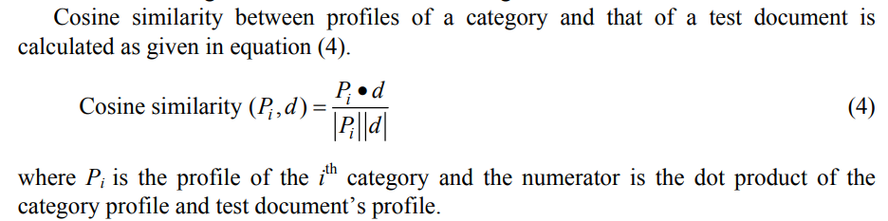
Similarity

Slide 15
Classification of Wikipedia documents

Slide 16
Classification of Wikipedia documents
Classifier : (1) whole document
(2) IDES
IDES : (1) IDES alone
(2) IDES enhanced ( with title terms )

Slide 17
Classification of Wikipedia documents
Feature-weighting scheme : (1) whole document : TF * NCD
(2) IDES alone : TF (variant)
New incoming document : TF-IDF

Slide 18
Negative category document frequency
If there are n categories, the (n – 1) categories other than the correct category can be considered as negative categories.
Reducing the weight of terms according to their presence in more negative categories.
Notes:
(2)根據terms在更多negative類別中的存在來減少權重。

Slide 19

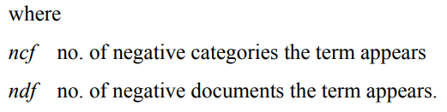
Negative category document frequency
We have applied NCD along with average TF for profile creation.
The feature weighting scheme used is TF*NCD.

Slide 20
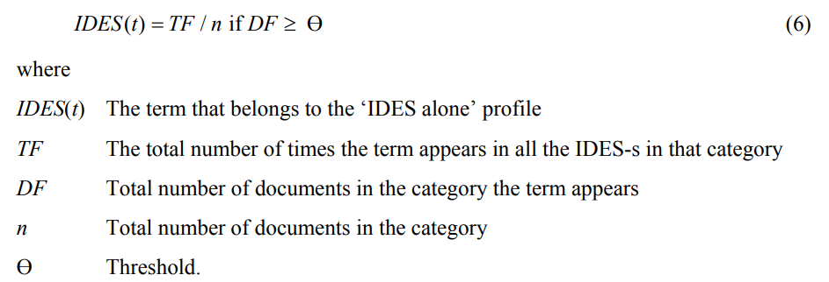
Initial description based approach
10%
Titles of sections and subsections : TF*NCD (No dimensionality reduction)
Combined IDES = enhanced IDES

Slide 21
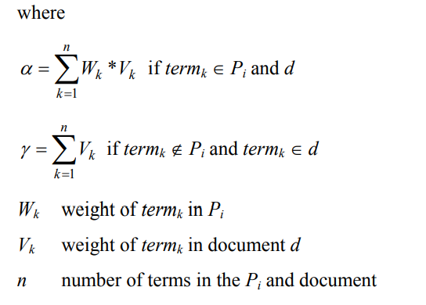
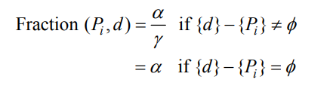
Similarity measures
Fractional similarity is a measure that has the advantage that it punishes a document if it contains terms that are not present in the category profile under consideration.
Notes:
它的優點是，如果文檔中包含的Term不在考慮中的類別中，則它會懲罰該文檔。

Slide 22
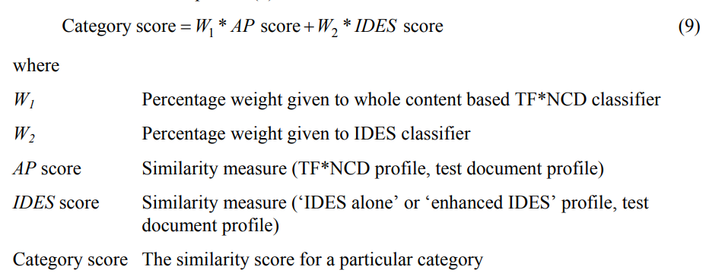
Combination of two classifiers

Slide 23
Experimental results and evaluation

Slide 24
Experimental results and evaluation
INEX Corpus subset : 96,611 documents / 21 categories
Training set / Testing set : 50 / 50
Feature weighting schemes :
(1) test documents : TF-IDF
(2) IDES : average TF
(3) whole document : TF * NCD

Slide 25
Experimental results and evaluation
Since dimensionality reduction is necessary, for the whole content based methods,
we set a threshold of top 3% for profile creation (Rogati and Yang, 2002).
Of the various combinations we have tried, we have concluded that 90% W1 and 10% W2 provides the best results.

Slide 26
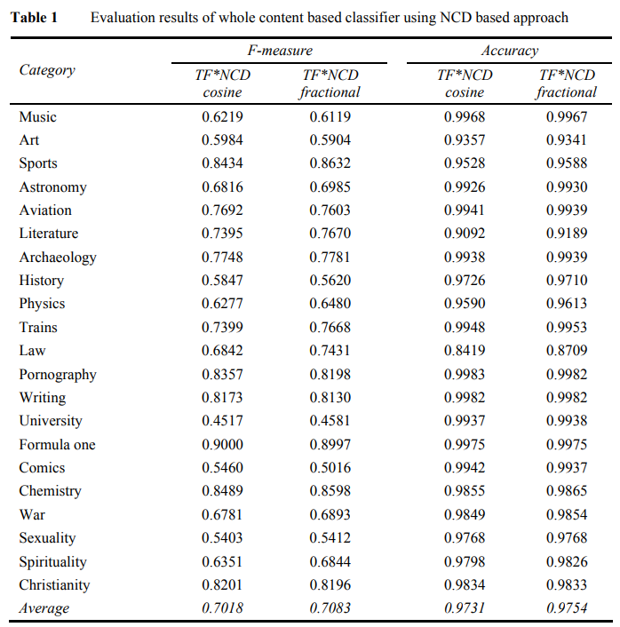
Experimental results and evaluation

Slide 27
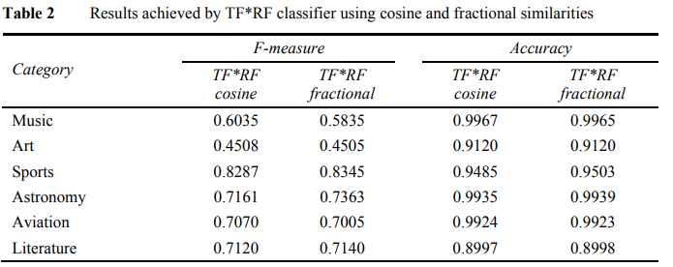
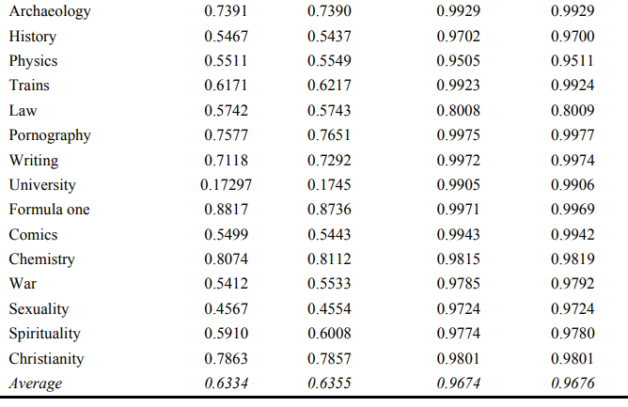
Experimental results and evaluation

Slide 28
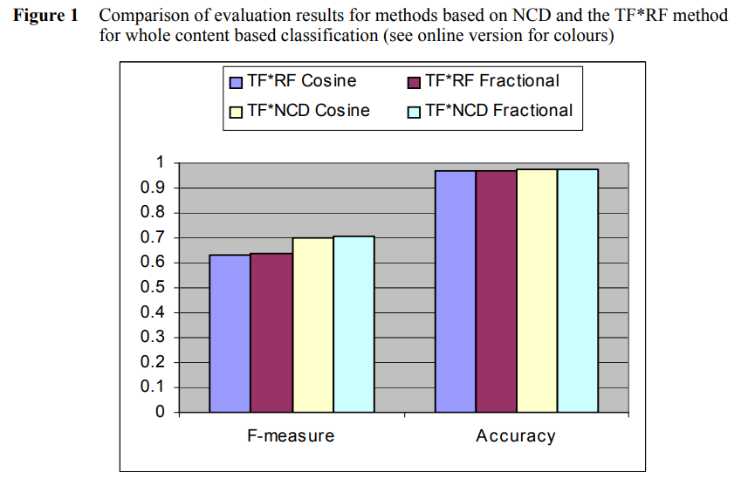
Experimental results and evaluation

Slide 29
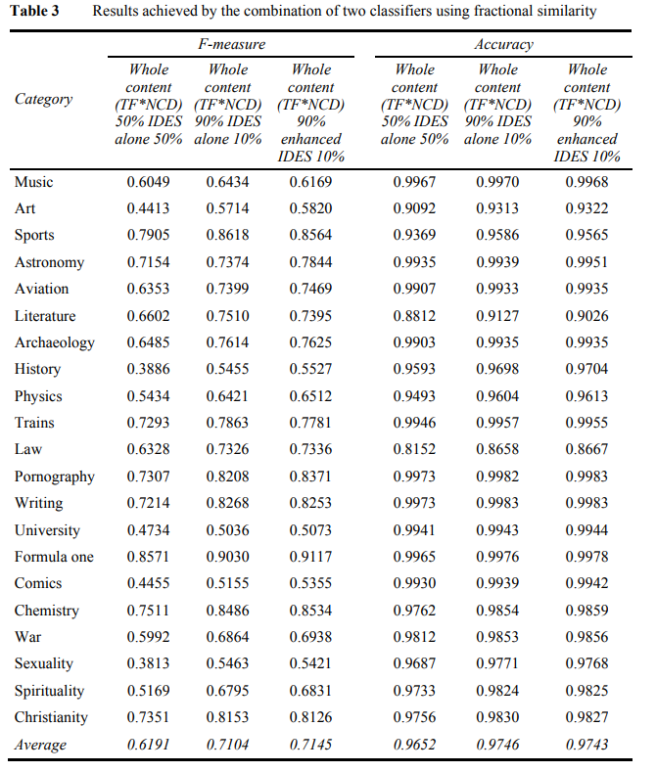
Experimental results and evaluation

Slide 30
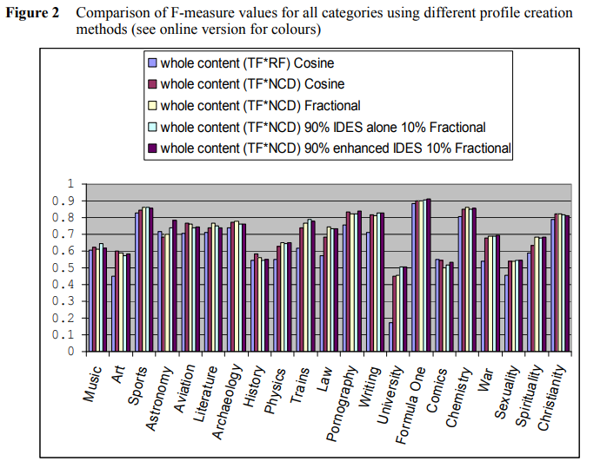
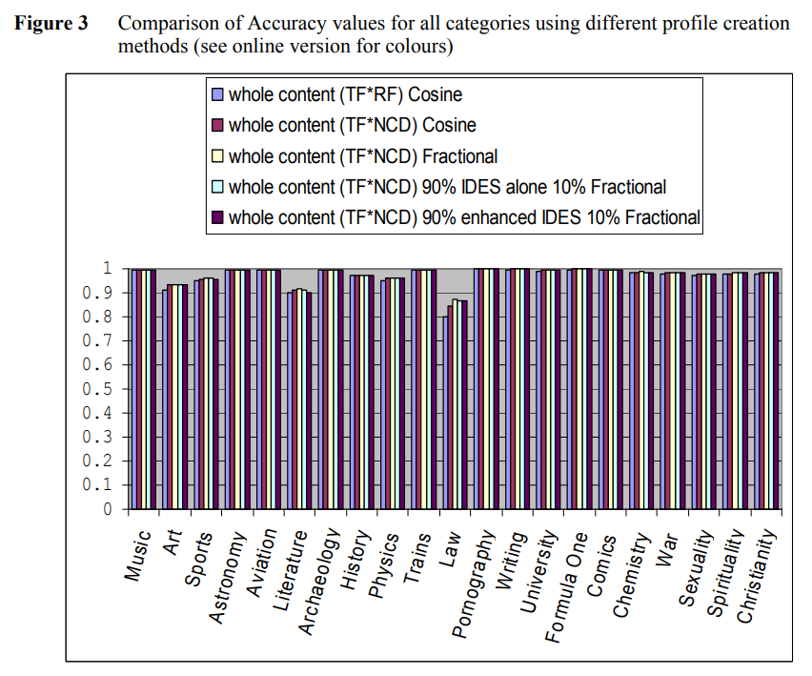
Experimental results and evaluation

Slide 31
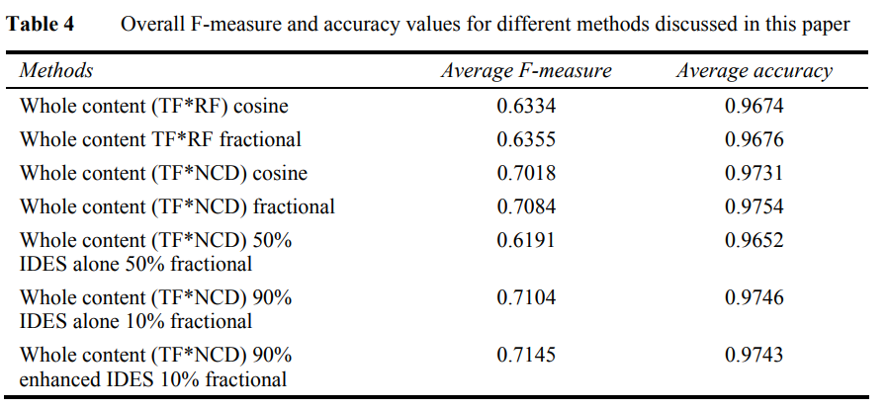
Experimental results and evaluation

Slide 32
Conclusions

Slide 33
Conclusions
NCD based profile creation proved to perform well for non-overlapping categories.
The IDES of the Wikipedia documents which contain domain specific terms helped to improve the performance of overall classification.
Combination of two classifiers has shown better results than any of the classifiers taken individually.
We also plan to extend this method, by exploring more Wikipedia specific structures such as links in a document.

Slide 34

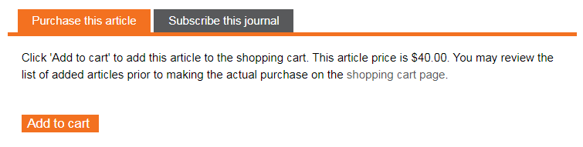


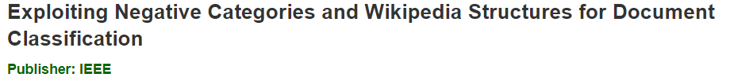

Slide 35
Thanks for listening.
報告者：610721204 陳克威
日 期：2019/12/25 (Xmas)

